Slide 1
King County House Data Analysis

Slide 2
Contents
Overview
Business and Data Understanding
Modeling
Regression Results
Recommendations
Next Steps

Slide 3
Overview
The project uses the house sales data in King County, Washington in 2021 and 2022.
The King County Real Estate Agency that helps homeowners buy and/or sell homes.The Real Estate agency need an advice to homeowners about what are the impact on the house prices.
Technical Tools used: Jupyter Notebook, Python (Sklearn, Pandas, Seaborn, Numpy, Matplotlib)

Slide 4
Business Understanding
This project is to build a regression model to help real estate agencies to check house price settings set by house owners.
In this analysis I will focus on the helping Real estate Agencies finding what indicators drive prices in house market.

Slide 5
Data Understanding
The dataset contains 25 columns and 30155 rows.
Target variable name is set to price.
Out of 25 columns 10 columns have object as data type.
All remaining 15 columns are of numerical type.

Slide 6
Important Points of Data Analysis
According to dataset typically home has 3 to 4 bedrooms. Other rooms count way less than the average.
Most of the houses have 1000 to 3000 of sqft_living area in dataset.
Bathrooms are positively correlated with higher pricing.
There is a relationship between the grade and price of the property. Higher the grade, higher the price.
Living Space is also positively correlated with house price.As we increase the living space of the house, value of the property price goes up.

Slide 7
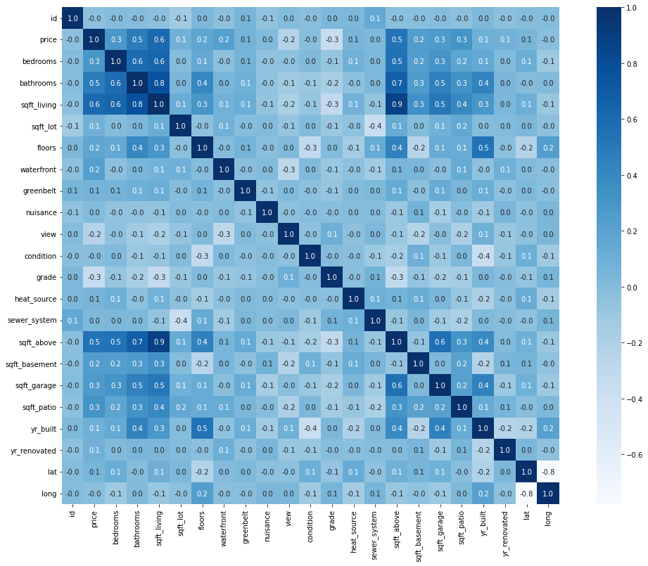
Correlation Heatmap
Notes:
Looking the correlation matrix of the data I will answer what is the target realtionship with variables. In the heatmap darker the color is maximum the correlation. The price(target variable) has high correlation with, bedrooms, bathrooms, sqft_living, floors, waterfront, view, grade, sqft_above, sqft_above, lat and sqft_living15.

Slide 8
Modeling
We splitted our dataset into 75% training size and 25% test size.
Firstly we trained our dataset on Linear Regression.
Linear Regression does not show good results.
So we trained our data on 15 different regression models including Random forest, Gradient Boosting and XGboost etc.
XGboost yields the highest score and out performed all other models.
We took XGboost as our final model and optimized it by tuning its hyperparameters.

Slide 9
Regression Results
Regression Model | R2 Score
Linear Regression | 0.5166
Gradient Boosting | 0.8843
Bayesian Ridge | 0.5166
KNeighbors | 0.7389
Decision Tree | 0.7974
AdaBoost | 0.7708
XGB | 0.8909

Slide 10
Recommendations
For someone buying a house an optimal setting will be 3 bedrooms and 2 bathrooms with a living space of around 2,000 square feet.
A house like this will cost around 1 million USD.
Waterfront houses will have slightly higher prices.

Slide 11
Next Step
Find a relationship between year renovated and prices and try to integrate it to the regression model.
Use the longitude and latitudes to predict the price based on the location of the house in King county.

Slide 12
THANK YOU!

